Slide 1
Product Planning for 2H19
10 Jul 2019

Slide 2
Objectives for this session
Look back at what we’ve created (“v6”)
Discuss what the next stage of KOKO (“v7”) looks like & how we might get there
Discuss changes in how we work that help get us ready
Discuss plans for completing v6.x in Q3

Slide 3
v6 Ecosystem
Software suite

Slide 4
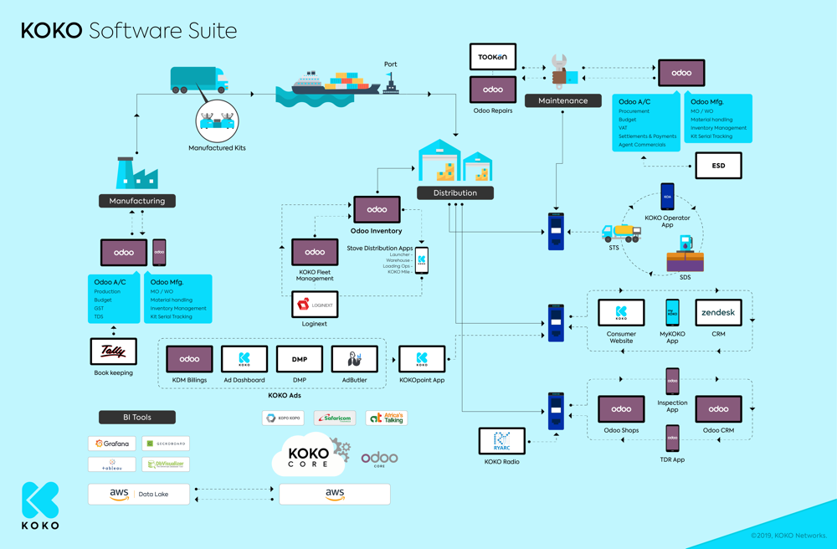
Software Suite v6
Notes:
23 custom products
10 integrations

Slide 5
KOKO Business in a Box
KP production
KSPS
Package
Manufacturing
Fuel Logistics
Package
Stove Distribution & Maintenance
Package
Accounting
Customer
Package
KOKO Digital
Agent Management
Package
Reporting
Package
Core Platform
KOKO
Radio
Notes:
Only agent management is explored and we have enough experience to start thinking about productising it.

Slide 6

KOKO Business in a Box
KP production
KSPS
Package
Manufacturing
Fuel Logistics
Package
Stove Distribution & Maintenance
Package
Accounting
Customer
Package
KOKO Digital
Agent Management
Package
Reporting
Package
Core Platform
KOKO
Radio
Notes:
Only agent management is explored and we have enough experience to start thinking about productising it.

Slide 7
v7 Vision
Software Roadmap

Slide 8
The next stage of KOKO (v7)
Nairobi network is running well on v6.x technology
KOKO is the Network Operator
New networks are being deployed in other markets (v7)
Run by “KOKO-licensed” Network Operators
KOKO resells v7 hardware & software to Operator, and provides consulting services to help the Operator design, implement & operate profitable Network
KOKO earns fuel throughput-based license fees from use of v7 software
KOKO v7 platform extends beyond v6.x with core new KDM & Labs offerings
E.g. Digital content distribution, Retail/ecommerce, etc.

Slide 9
Building v7 requires going through v6 Learning Curve
700 KPs
30,000 customers
$100,000 monthly KDM revenue
700 KPs
60,000 customers
$500,000 monthly KDM revenue
300 KPs
700 KPs
10,000 customers
Learning v6
Agent Management
KP & Fuel Logistics
Demand creation
Operations at scale
Learning from building the agent management pipeline
KP Deployment & Maintenance.
Fuel Logistics management
Customer toolkit to generate demand
Reporting needs
Support tools
Building v7

Slide 10
Reorganising to organise for v7
v6.x Team
New hires?
+
Existing members
v7 Team
V7 team skills and experience needed:
Intrinsic knowledge and informed skepticism gleaned from Nairobi and Kenya operation
Technology franchising experience and fresh perspectives

Slide 11
The v7 Organisation must be optimized for developing & selling enterprise solutions
Executive
(KOKO Solutions)
Enterprise sales to KOKO licensees
Business development
Account mgmt
Understand market needs
Build & develop tech roadmaps (HW & SW)
Support sales & delivery
...
Solution Owner
(Partner Solutions)
Solution Owner (Consumer Solutions)
Solution Owner (Operator Solutions)
Software Eng
Hardware Eng
Support
Data & BI

Slide 12
Preparing for v7
Improvements in how we work

Slide 13
Key Themes to keep in mind:
Version 6.x
Theme 1. Proactive Product Improvements:
Goal 1.1 Review existing products and features and identify critical usability, functionality and performance improvements
Goal 1.2 Review dependent and integrated products and identify key gaps or improvements in design, functionality or reliability
Goal 1.3 Reduce technical debt accumulated over the last few months and improve overall documentation
Theme 2. Rapid Support and Robust Infrastructure:
Goal 2.1 Enhance our support team setup, tools and structure to support and fix any field issues swiftly and with minimum impact
Goal 2.2 Improve our ability to proactively monitor and maintain remote technology infrastructure
Goal 2.3 Improve reliability of our data infrastructure and reporting tools
Version 7.0
Theme 3. Making the technology franchisable (to be defined more clearly)
Theme 4. Taking an ‘integrated Product’ view (i.e., Hardware, Software, Systems & Services)
Theme 5: Future Proofing / Readiness for KOKOlabs solutions (esp. Retail & Digital Content Distribution)

Slide 14
Proposed changes to the way we work (Q3 onwards)
Improve Engineering Delivery Management
Clearer interfaces (with better oversight) between
between Business Areas & Product
between Product & Engineering
Streamlined communications

Slide 15
1) Improved Engineering Delivery Management
Current way of working
Product Owners “own” scrum teams, define work, and handle most aspects of delivery management
Product Owner
Product Team 1
Scrum team 1
Proposed way of working:
Free up Product Managers from delivery management for more product development of v6.x and v7
PMs spend more time with Launch Exco to improve understanding, buy in and get sign off on new features
Improvements in Engineering team required:
Place ownership of delivery of features with Engineering team
Improve other technical and soft skills of engineers to build more scalable teams
Launch Exco
Eng Mgmt
Product Owner
Handover
Delivery Manager
Product Team 1
Scrum team 1

Slide 16
2) Clearer structures & interfaces
Product
Engineering
Sagun
KR & MdC
Customer (AM)
Network & Partner (TM)
ERP & KSPS (AJ)
Android & Field Systems (KO)
Cloud & Data (SS)
Quality Assurance (GJ)
Business stakeholders
DM
Scrum teams
Role Expectations:
Analyse and articulate user needs, incorpo- rating latest updates from launch team and operations
Drive roadmapping and prioritisation; get buyin
Conduct financial cost-benefit analysis and budgeting for Products (KOKO and 3rd party) together with Business
Prepare requirements for handover to engineering
Drive product onboarding and adoption by users
Role Expectations:
Plan and estimate and engineer features for feedback to Product and Business
Provide feedback on specifications and completeness of requirements for new features
Establish, monitor and improve ways of working
Manage Scrum team day-to-day
Provide progress visibility for work under way
Track cost of delivery for features

Slide 17
3. Improved communications processes
Participants: Sagun and all Product Owners, with MdC and KR supporting
Focus: Discuss Product performance, Capture concerns/input from launch Exco & Mgmt, Review Roadmaps & discuss potential updates; Agree on prioritisation of Roadmap changes; Communicate improvements to existing Products for business; Incl. Technical debt considerations
1
Product Roadmap Meeting
Participants: POs and DMs (with Eng Mgmt overseeing as required)
Focus: Review features prepared for development; Prioritization; Clarify requirements and review key test cases
2
Handover
Meetings
Participants: DMs and team members (with Eng Mgmt overseeing as required)
Focus: Engineering design and estimation for handed-over features, assignment of work to developers
3
Engineering
Meetings
Participants: DMs and team members (with Eng Mgmt overseeing as required)
Focus: Continuous monitoring of delivery to track progress and address issues, plus other Scrum goals (retros etc)
4
Scrum
Meetings

Slide 18
Q3 Planning
How to Identify & Prioritise v6.x improvement areas

Slide 19
Product team will facilitate focused Roadmap planning workshops in July
V6.x improvements to be discussed and prioritised in context of the Themes
Consumer products and journeys
Sales tools,
Topup from other number, Other products , Website
Agent products and journeys
Delivery of stoves, Fulfillment, Staff Training, Support, Dashboard?
Partner (Vivo) products and journeys
Fuel ops: KP refilling, MT refilling, Reconciliation of money & inventory, Reporting Metrics for Vivo
Operator (KOKO) products and journeys
Stove distribution & returns, NOC processes, Network Maintenance,...
KDM?
Notes:
Customer Products
Partner Products
Operator / KOKO Products

Slide 20
Workshop Team and Participants
The workshops will involve a wide range of representatives (agreed with Exco)
Focus
(Customer Products)
Owner
(Sagun)
Facilitators
(Stephan, Alice, Amar …)
Attendees
(Exco, Product, Engineering, Operations)

Slide 21
Workshop Timeline per Topic
Prepare focused agenda
Workshop owner and facilitators prepare the prioritised list of questions along with facilitators to help create a focused agenda for the workshop day.
This would include eliminating duplicate questions, finalising list of questions and preparing crisp and focused answers, streamlining the flow of discussion, time check etc.
Source questions (re: gaps, concerns, ideas)
Prepare question list sourced by all attendees and start preparing answers with notes in the same sheet. (4 hours per participant) 60-80 hours of thought
It is important people carve out this time to focus and think about these topics so that we can develop clear requirements.
T - 3 days
T
T - 5 days
T - 2 days
Start preparation
Stop sourcing of questions to give facilitators 2 days to prepare. Many questions may only have suggestion and will invite discussions in the group. For the remaining 2 days, participants will engage through comments and discussions over the documents.
.
Workshop
Workshop owner conducts the presentation with facilitators. Facilitators make notes. Prepare action points - items to be scoped for development or to be discussed or researched further
Product managers prepare and confirm setup of JIRA stories for the items to be scoped for development and setup meetings for items to be discussed and researched further.
.

Slide 22
Extra slides
Workshop planning

Slide 23
Other discussion points
Cost of change is higher later in the process
Documentation - How to
Indispensable and Optional requirements from each package
Operational viability of certain processes for a franchises, Product specifications systems and software (part life, service frequency .. )
Investment and resourcing
Artificial intelligence based decision making

Slide 24
C1. Sample question set
Estimates demand of how much cookers and canisters we need?
How many different types of products / SKUs are we selling?
How do we know how much quantity is in stock?
How do we estimate how much quantity we need?
Who estimates and decides?
What information systems do they use?
Is this documented somewhere?
What is the process to add a new product to the process?

Slide 25
C1. Sample question set
Places order for cookers and canisters to India factory
What is the PO process and exact workflow?
Who prepares and who approves the POs?
Who sends the PO to India factory?
Who acknowledges in India factory? What is the process?
How would the process look like if we were taking orders from multiple countries?
Is there a TAT for Cooker Kits for India?
How can we track the status of our order?
Is this documented somewhere?
What is the process to add a new product to the process?
India factory manufactures Cookers
How does it track the process?
How does it know how much raw material to order and what is remaining?
Is this documented somewhere?
What are the changes to process to add a new product?

Slide 26
Product and engineering management
Current way of working
PMs “own” scrum teams, define work, and handle most aspects of delivery management
PM
Product Team 1
Scrum team 1
Desired improvements
Free up product managers from delivery management for product development
Place ownership of delivery of features with engineering team
Tighten handover process
Eng Mgmt
PM
Handover
DM
Product Team 1
Scrum team 1
Question
Should PMs have a common reporting line, or at least a review and sign off for features and improvements to be built by development team - each sprint is a ~20k USD investment in software

Slide 27
Notes from discussions this week (1 July 2019)
Time taken to

Slide 28
Suggested new meetings and their focus
Product planning: SS and Product Owners, with MdC and KR supporting
Focus: Discussion of product performance, concerns/input from launch team, key priorities and updates to workplans, sharing planned improvements to existing products
Handover meetings: POs and DMs (with Eng Mgmt overseeing as required)
Focus: Review of features prepared for development, clarification of requirements and review of key test cases
Engineering meeting: DMs and team members (with Eng Mgmt overseeing as required)
Focus: Engineering design and estimation for handed over features, assignment of work to developers
Scrum meetings: DMs and team members (with Eng Mgmt overseeing as required)
Focus: Continuous monitoring of delivery to track progress and address issues

